Slide 1
Cloud Skills Challenge
*Account* data Challenge

Slide 2
*Account* Data Challenge Agenda
1
Why running a Cloud Skills Challenge in your organization?
2
What to expect for the Cloud Skills Challenge – *Account* Data Challenge?
3
How to kick off the *Account* Data Challenge for your collaborators?
Notes:
For ESI customers, the TPM/iTPM must be consulted & provide approval before CSC is implemented. Be sure to always align with TPMs/iTPMs if you are considering running a challenge with ESI customers.
Andrea Waugh Metzger: LOVE Skills Challenge! I had a 60% conversion rate for ACAs last year when I ran challenges

Slide 3
*Account* Data Challenge Why running a Cloud Skills Challenge in your organization?
27% of total roles will be new by 2022 in comparison to 16% in 2018¹
62% of executives believe they need to retrain or replace more than a quarter of their workforce by 2023²
74% of employees ready to completely retrain in order to remain employable in the future³
2018
2022
Skill gaps lead to higher levels of stress, delays in development, deployment of critical projects, and even loss of revenue¹
Invest in upskilling and training your teams with engaging experiences
Reward employees that invest in learning
Prioritize certification in hiring and recruiting
World Economic Forum” The Future of Jobs & Skills
McKinsey Survey: Retraining and reskilling workers in the age of automation
PwC 2018 Saratoga: Rethinking HR for the future of work
Notes:
For ESI customers, the TPM/iTPM must be consulted & provide approval before CSC is implemented. Be sure to always align with TPMs/iTPMs if you are considering running a challenge with ESI customers.
Andrea Waugh Metzger: LOVE Skills Challenge! I had a 60% conversion rate for ACAs last year when I ran challenges

Slide 4
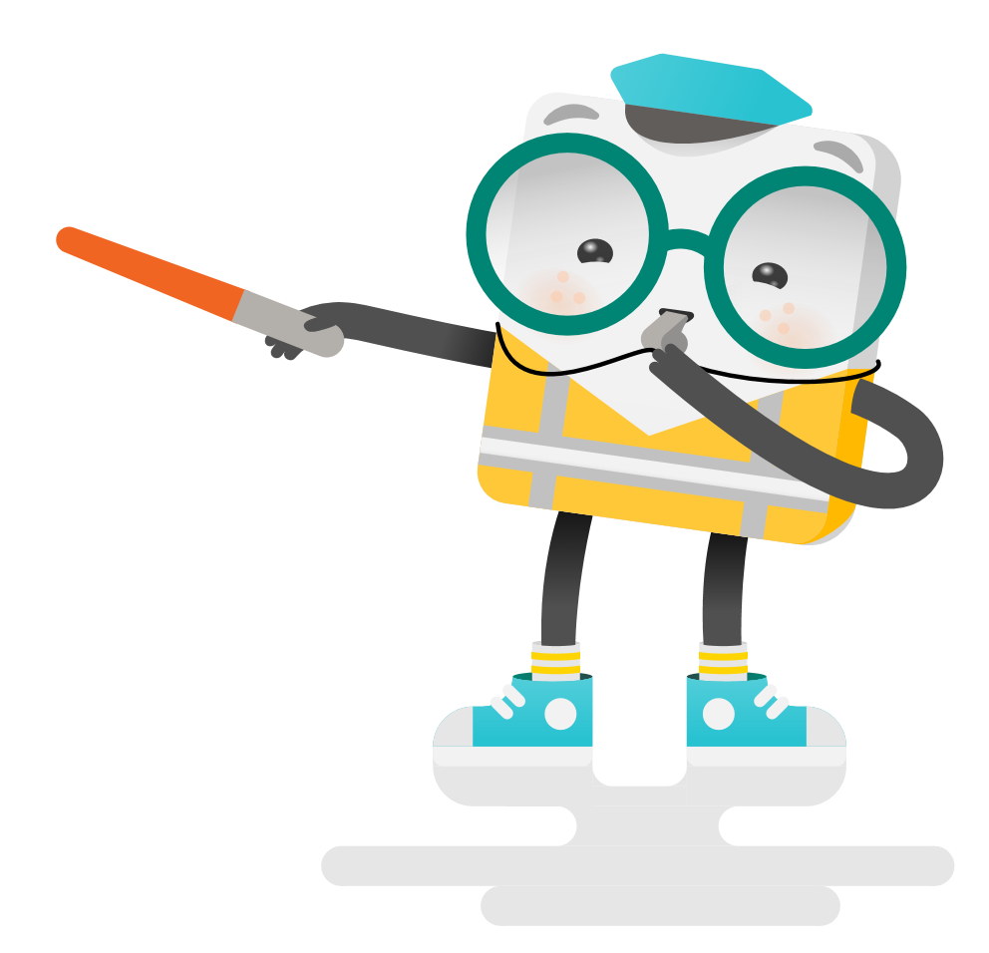
*Account* Name the Challenge What to expect for the Cloud Skills Challenge – *Account* Data the Challenge?
Week 1
4 weeks self-learning program
Microsoft invites you for the *Account* Data Challenge. In just 4 weeks, you will understand the basics of Microsoft’s Data Analytics Resources.
Go from zero to hero with Data to set your company up for future app development success.
AZURE FOR THE DATA ENGINEER
2H30
Week 2
ANALYTICAL SOLUTIONS WITH AZURE SYNAPSE ANALYTICS
3H30
Week 3
DATA INGESTION ON AZURE
3H00
Week 4
AZURE DATABRICKS
4H00
The Bootcamp is a 4 week program with self-paced learning content separated for each week. In the end of each week you will have a weekly ramp-up email and office hours with extra resources. The bootcamp starts and ends up with Hands-On Workshop on Data Analytics with Microsoft proctors.
Notes:
For ESI customers, the TPM/iTPM must be consulted & provide approval before CSC is implemented. Be sure to always align with TPMs/iTPMs if you are considering running a challenge with ESI customers.
Andrea Waugh Metzger: LOVE Skills Challenge! I had a 60% conversion rate for ACAs last year when I ran challenges

Slide 5
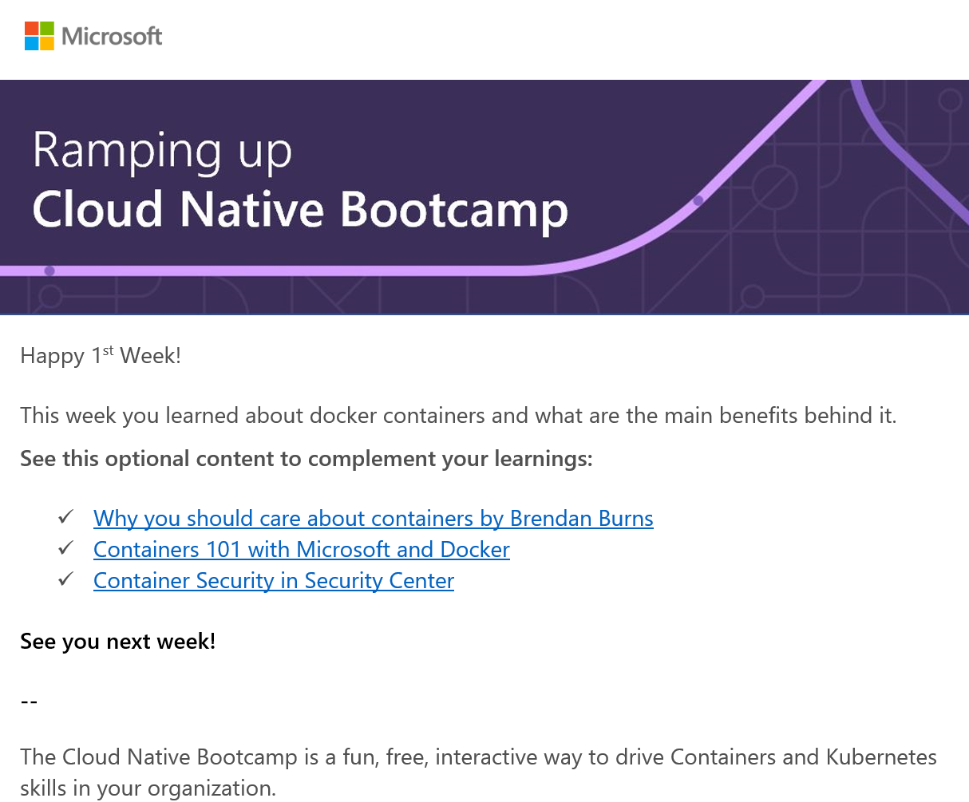

*Account* Name the Challenge What to expect for the Cloud Skills Challenge – *Account* Name the Challenge?
Kick Off Session | TBD 2021
Weekly Check Up | TBD 2021
Weekly workshop/session to wrap up on the learning and additional content
Full Day Workshops | TBD 2021
Kubernetes Hands-On Workshop
Notes:
For ESI customers, the TPM/iTPM must be consulted & provide approval before CSC is implemented. Be sure to always align with TPMs/iTPMs if you are considering running a challenge with ESI customers.
Andrea Waugh Metzger: LOVE Skills Challenge! I had a 60% conversion rate for ACAs last year when I ran challenges

Slide 6
*Account* Name the Challenge What to expect for the Cloud Skills Challenge – *Account* Name the Challenge?
Proposed Calendar
MON | TUE | WED | THU | FRI
 |  |  |  | Containers Workshop (Full Day)
 |  |  |  | Bootcamp Office Hours (1h30)
 |  |  |  | Bootcamp Office Hours (1h30)
 |  |  |  | Kubernetes Workshop (Full Day)
Azure for the data engineer self-learning gamification, 2h30
Analytical solutions with azure synapse analytics self-learning gamification, 3h30
Data ingestion on azure self-learning gamification, 3h00
Azure databricks self-learning gamification, 4h00
Notes:
For ESI customers, the TPM/iTPM must be consulted & provide approval before CSC is implemented. Be sure to always align with TPMs/iTPMs if you are considering running a challenge with ESI customers.
Andrea Waugh Metzger: LOVE Skills Challenge! I had a 60% conversion rate for ACAs last year when I ran challenges

Slide 7
*Account* Name the Challenge How to kick off the Kubernetes Bootcamp for your collaborators?
1
Choose a sponsor for your organization (IT Director, CIO, CTO)
2
Choose a date to start the *Account* Data Challenge
3
Send the invites and meetings requests provided by Microsoft to potential participants
4
Keep track of the leaderboard and encourage your collaborators together with Microsoft
Notes:
For ESI customers, the TPM/iTPM must be consulted & provide approval before CSC is implemented. Be sure to always align with TPMs/iTPMs if you are considering running a challenge with ESI customers.
Andrea Waugh Metzger: LOVE Skills Challenge! I had a 60% conversion rate for ACAs last year when I ran challenges

Slide 9
